Slide 1
CSE-1200
Software Development PROJECT: super smasher 2d
Group: 07
DIPESH SHOME Md.ar-raji billah
id: 16-02-04-045 id: 16-02-04-053

Slide 2
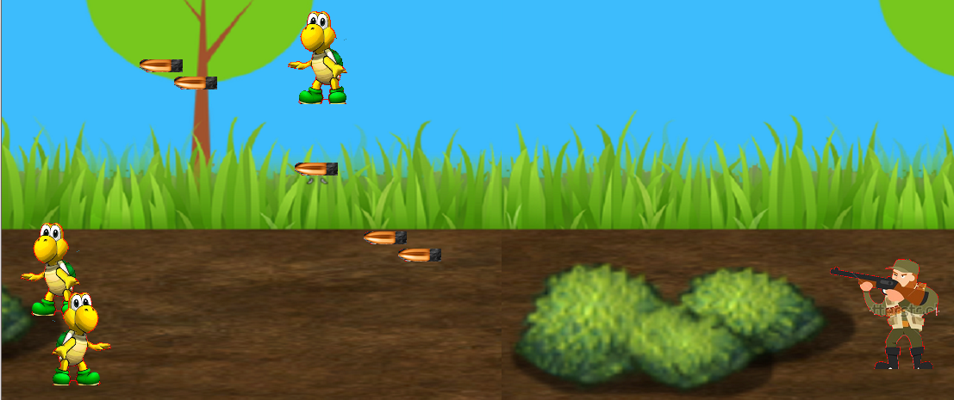
INTRODUCTION
2D Arcade game
Hunting Related
A hunter shooting multiple targets
SPECIAL FEATURES
Player has 3 lives
10 points for each shot
Game Over, if-
3 enemies escape or,
3 enemies get too close or,
both

Slide 3
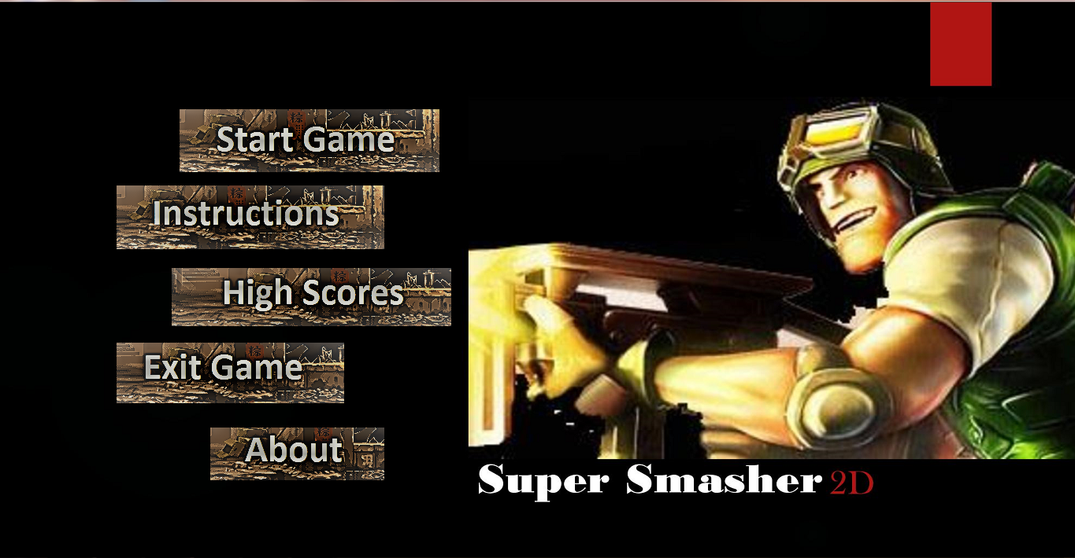
MAIN MENU

Slide 4
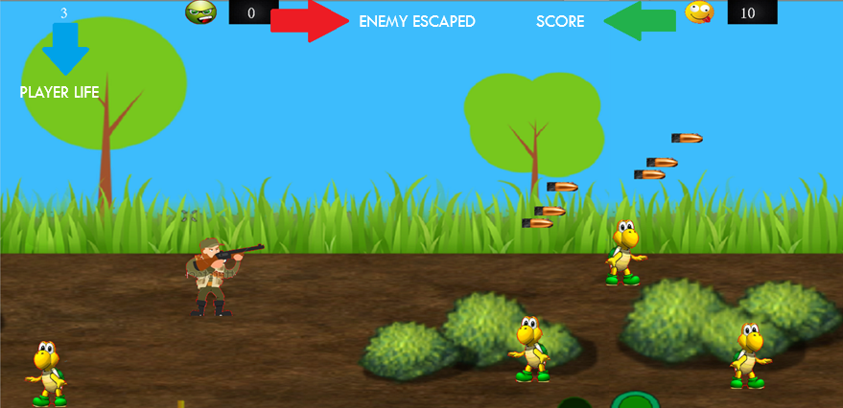
GAME INTERFACE

Slide 5
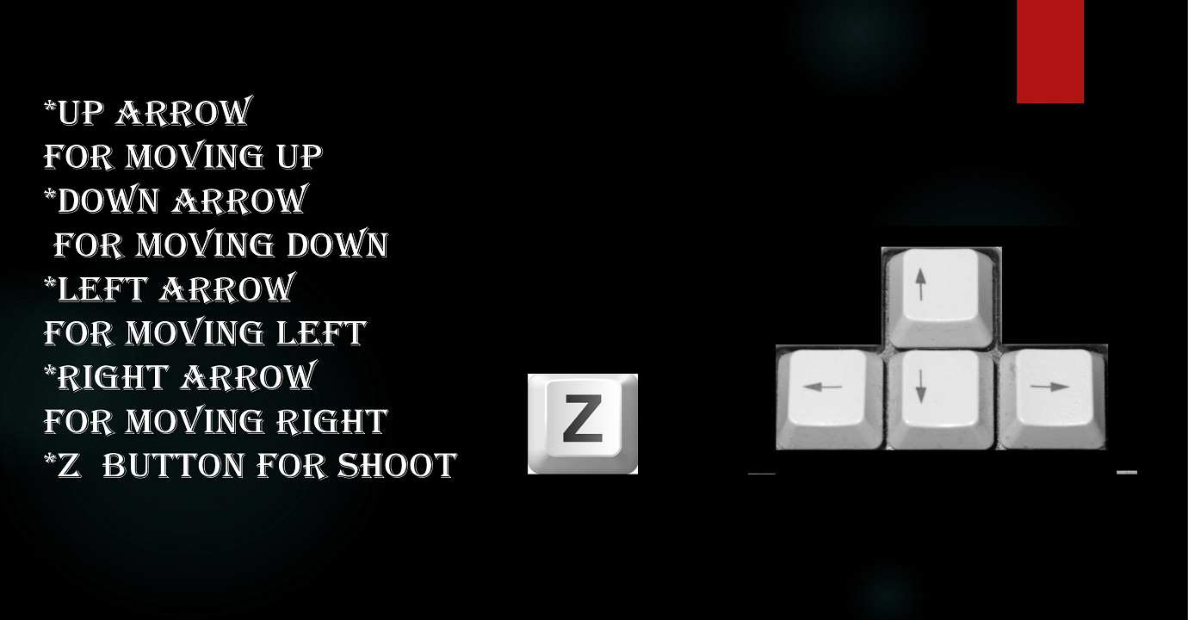
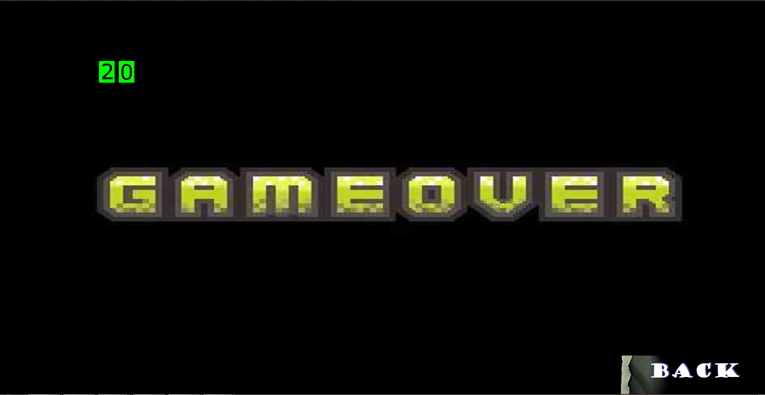
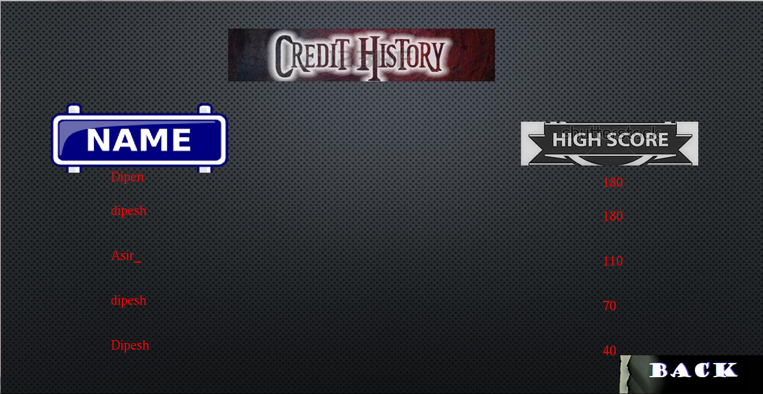
CONTROLS
GAME ENDING
& then…
GAME OVER SCREEN
USERNAME INPUT & HIGHSCORE SCREEN

Slide 6
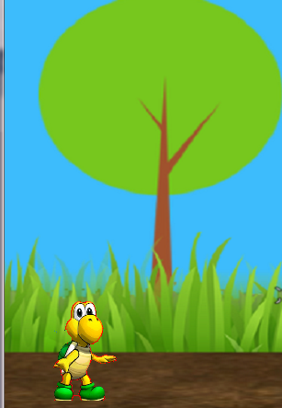
Goodbye!
THANK YOU

